Slide 1

18CSC202J Object Oriented Design and Programming
Prepared by
Department of Data Science and Business Systems & Networking and Communications

Slide 2
Session 1
Topic : Types of Constructor

Slide 3
CONSTRUCTORS
It is very common for some part of an object to require initialization before it can be used.
Suppose you are working on 100's of objects and the default value of a particular data member is needed to be zero.
Initializing all objects manually will be very tedious job.
Instead, you can define a constructor function which initializes that data member to zero. Then all you have to do is declare object and constructor will initialize object automatically

Slide 4
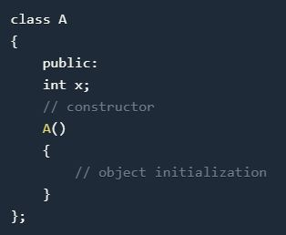
CONSTRUCTORS
While defining a constructor you must remember that the name of constructor will be same as the name of the class, and constructors will never have a return type.

Slide 5
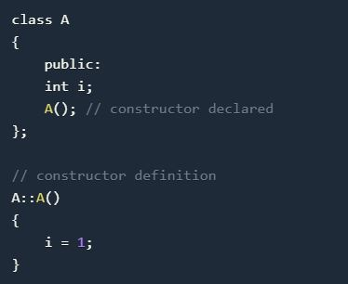
CONSTRUCTORS
Constructors can be defined either inside the class definition or outside class definition using class name and scope resolution :: operator.

Slide 6
CONSTRUCTOR CHARACTERS
They must be declared in the public scope.
They are invoked automatically when the objects are created.
They do not have return types, not even void and they cannot return values.
They cannot be inherited, though a derived class can call the base class constructor.
Like other C++ functions, Constructors can have default arguments.

Slide 7
Constructors cannot be virtual.
We can not refer to their addresses.
An object with a constructor (or destructor) can not be used as a member of a union.
They make ‘implicit calls’ to the operators new and delete when memory allocation is required.

Slide 8
CONSTRUCTOR TYPES
Constructors are of three types:
Default Constructor
Parameterized Constructor
Copy Constructor

Slide 9
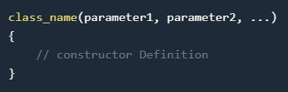
DEFAULT CONSTRUCTOR
Default constructor is the constructor which doesn't take any argument. It has no parameter.
Syntax :

Slide 10
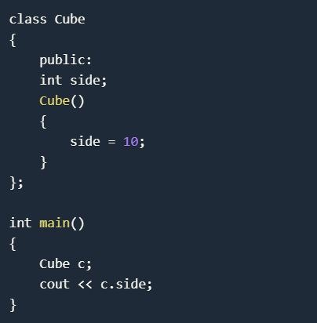
DEFAULT CONSTRUCTOR
Example
Output : 10

Slide 11
DEFAULT CONSTRUCTOR
As soon as the object is created the constructor is called which initializes its data members.
A default constructor is so important for initialization of object members, that even if we do not define a constructor explicitly, the compiler will provide a default constructor implicitly.

Slide 12
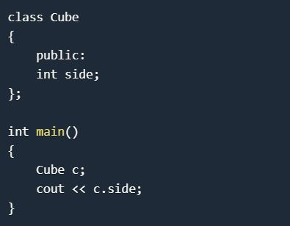
DEFAULT CONSTRUCTOR
Output: 0 or any random value
In this case, default constructor provided by the compiler will be called which will initialize the object data members to default value, that will be 0 or any random integer value in this case.

Slide 13
PARAMETERIZED CONSTRUCTOR
These are the constructors with parameter.
Using this Constructor you can provide different values to data members of different objects, by passing the appropriate values as argument.

Slide 14
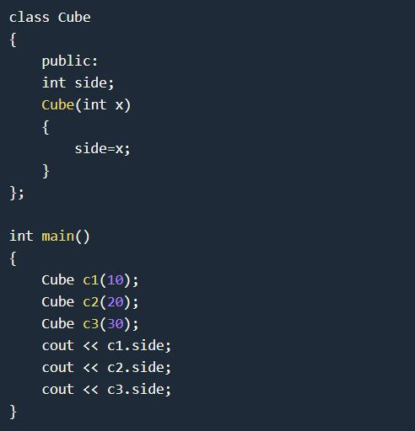
PARAMETERIZED CONSTRUCTOR
OUTPUT
10
20
30

Slide 15
PARAMETERIZED CONSTRUCTOR
By using parameterized constructor in above case, we have initialized 3 objects with user defined values. We can have any number of parameters in a constructor.

Slide 16
COPY CONSTRUCTOR
These are special type of Constructors which takes an object as argument, and is used to copy values of data members of one object into other object.

Slide 17
COPY CONSTRUCTOR
These are special type of Constructors which takes an object as argument, and is used to copy values of data members of one object into other object.
It is usually of the form X (X&), where X is the class name. The compiler provides a default Copy Constructor to all the classes.

Slide 18
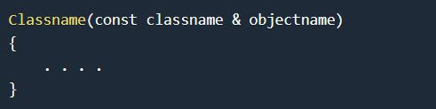
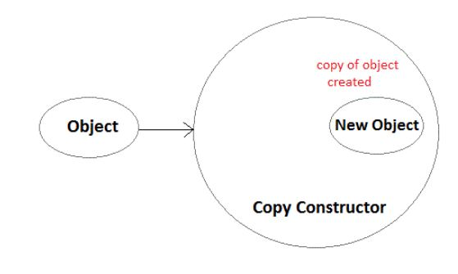
COPY CONSTRUCTOR
As it is used to create an object, hence it is called a constructor. And, it creates a new object, which is exact copy of the existing copy, hence it is called copy constructor.

Slide 19
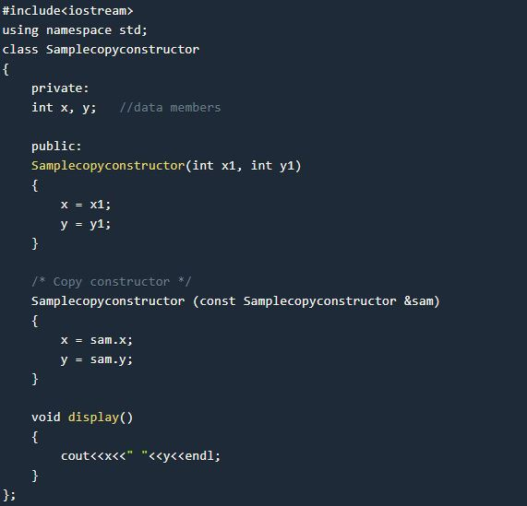
COPY CONSTRUCTOR

Slide 20
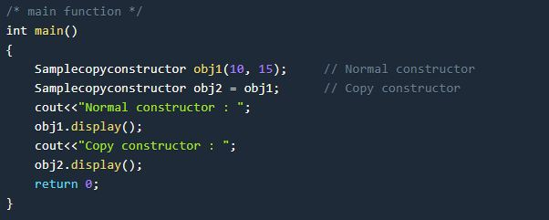
COPY CONSTRUCTOR
Output :
Normal constructor : 10 15
Copy constructor : 10 15

Slide 21
STATIC CONSTRUCTOR
C++ doesn’t have static constructors but you can emulate them using a static instance of a nested class.
class has_static_constructor {
friend class constructor;
struct constructor {
constructor() { /* do some constructing here … */ }
};
static constructor cons;
};
// C++ needs to define static members externally.
has_static_constructor::constructor has_static_constructor::cons;

Slide 22
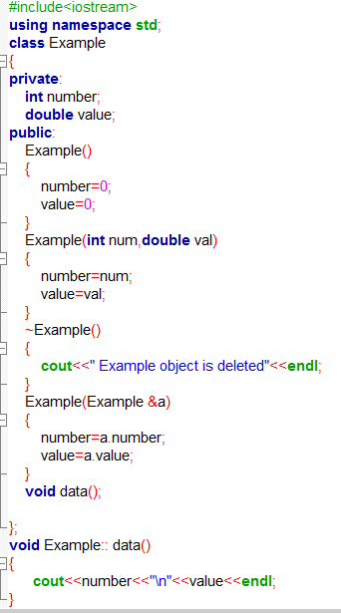
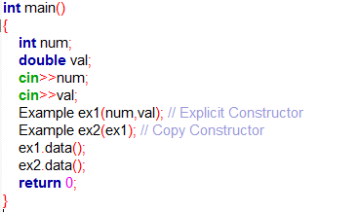
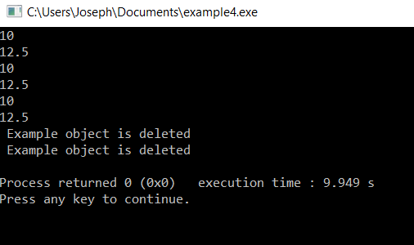
Try out program

Slide 23
Questions
What is a copy constructor? a) A constructor that allows a user to move data from one object to another b) A constructor to initialize an object with the values of another object c) A constructor to check the whether to objects are equal or not d) A constructor to kill other copies of a given object.
What happens if a user forgets to define a constructor inside a class? a) Error occurs b) Segmentation fault c) Objects are not created properly d) Compiler provides a default constructor to avoid faults/errors.
How many parameters does a copy constructor require? a) 1 b) 2 c) 0 d) 3

Slide 24
Session 2 & 3
Feature Polymorphism: Constructor overloading &
Method overloading

Slide 25
Polymorphism
The word polymorphism means having many forms.
In simple words, we can define polymorphism as the ability of a message to be displayed in more than one form.
Real life example of polymorphism: A person at the same time can have different characteristic. Like a man at the same time is a father, a husband, an employee.
So the same person posses different behaviour in different situations. This is called polymorphism.

Slide 26
Polymorphism
Polymorphism is considered as one of the important features of Object Oriented Programming.
Polymorphism allows us to perform a single action in different ways. In other words, polymorphism allows you to define one interface and have multiple implementations.
The word “poly” means many and “morphs” means forms, So it means many forms.

Slide 27
Polymorphism
Overloading
Constructor Overloading
Method Overloading
Operator Overloading
Overriding
Method Overriding

Slide 28
Constructor Overloading
In C++, We can have more than one constructor in a class with same name, as long as each has a different list of arguments. This concept is known as Constructor Overloading
Overloaded constructors essentially have the same name (name of the class) and different number of arguments.
A constructor is called depending upon the number and type of arguments passed.
While creating the object, arguments must be passed to let compiler know, which constructor needs to be called.

Slide 29
Constructor Overloading
In C++, We can have more than one constructor in a class with same name, as long as each has a different list of arguments. This concept is known as Constructor Overloading
Example
class construct{
public:
float area;
// Constructor with no parameters
construct() {
area = 0;
}
// Constructor with two parameters
construct(int a, int b) {
area = a * b;
}
void disp() {
cout<< area<< endl;
}
};
int main() {
construct o;
construct o2( 10, 20);
o.disp();
o2.disp();
return 1;
}
Output:
0
200

Slide 30
Constructor Overloading
// C++ program to demonstrate constructor overloading
#include <iostream>
using namespace std;
class Person { // create person class
private:
int age; // data member
public:
// 1. Constructor with no arguments
Person()
{
age = 20; // when object is created the age will be 20
}
// 2. Constructor with an argument
Person(int a)
{ // when parameterized Constructor is called with a value the age passed will be initialized
age = a;
}
Int getAge()
{ // getter to return the age
return age;
}
};
int main()
{
Person person1, person2(45);
// called the object of person class in differnt way
cout<< "Person1 Age = " << person1.getAge() <<endl;
cout<< "Person2 Age = " << person2.getAge() <<endl;
return 0;
}

Slide 31
MCQ Questions
Which among the following best describes constructor overloading?
a) Defining one constructor in each class of a program b) Defining more than one constructor in single class c) Defining more than one constructor in single class with different
signature d) Defining destructor with each constructor
Answer: c Explanation: If more than one constructors are defined in a class with same signature, then that results in error. The signatures must be different. So that the constructors can be differentiated.

Slide 32
MCQ Questions
2. Can constructors be overloaded in derived class?
a) Yes, always b) Yes, if derived class has no constructor c) No, programmer can’t do it d) No, never
Answer: d Explanation: The constructor must be having the same name as that of a class. Hence a constructor of one class can’t even be defined in another class. Since the constructors can’t be defined in derived class, it can’t be overloaded too, in derived class.

Slide 33
MCQ Questions
3. Does constructor overloading include different return types for constructors to be overloaded?
a) Yes, if return types are different, signature becomes different
b) Yes, because return types can differentiate two functions
c) No, return type can’t differentiate two functions
d) No, constructors doesn’t have any return type
Answer: d Explanation: The constructors doesn’t have any return type. When we can’t have return type of a constructor, overloading based on the return type is not possible. Hence only parameters can be different.

Slide 34
MCQ Questions
4. Why do we use constructor overloading?
a) To use different types of constructors b) Because it’s a feature provided c) To initialize the object in different ways d) To differentiate one constructor from another
Answer: c Explanation: The constructors are overloaded to initialize the objects of a class in different ways. This allows us to initialize the object with either default values or used given values. If data members are not initialized then program may give unexpected results.

Slide 35
MCQ Questions
5. Which constructor will be called from the object created in the code below?
class A
{ int i;
A()
{
i=0; cout&lt;&lt;i;
}
A(int x=0)
{
i=x; cout&lt;&lt;I;
}
};
A obj1;
a) Default constructor b) Parameterized constructor c) Compile time error d) Run time error
ANSWER : C
Explanation: When a default constructor is defined and another constructor with 1 default value argument is defined, creating object without parameter will create ambiguity for the compiler. The compiler won’t be able to decide which constructor should be called, hence compile time error.

Slide 36
Method Overloading
Method overloading is a feature in C++ that allows creation of several methods with the same name but with different parameters.
For example, print(), print(int), and print("Hello") are overloaded methods.
While calling print() , no arguments are passed to the function
When calling print(int) and print("Hello") , an integer and a string arguments are passed to the called function.
Allows one function to perform different tasks

Slide 37
Types of Polymorphism
Basically, there are two types of polymorphism:
Compile time (or static) polymorphism
Run-time (or dynamic) polymorphism.
Static polymorphism -> Method overloading - calls a function using the best match technique or overload resolution.

Slide 38
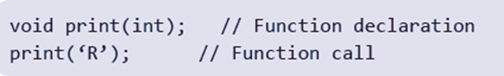
Matching Function Calls With Overloaded Methods
When an overloaded function is called, one of the following cases occurs:
Case 1: A direct match is found, and there is no confusion in calling the appropriate overloaded function.
Case 2: If a match is not found, a linker error will be generated. However, if a direct match is not found, then, at first, the compiler will try to find a match through the type conversion or type casting.
Case 3: If an ambiguous match is found, that is, when the arguments match more than one overloaded function, a compiler error will be generated. This usually happens because all standard conversions are treated equal.

Slide 39
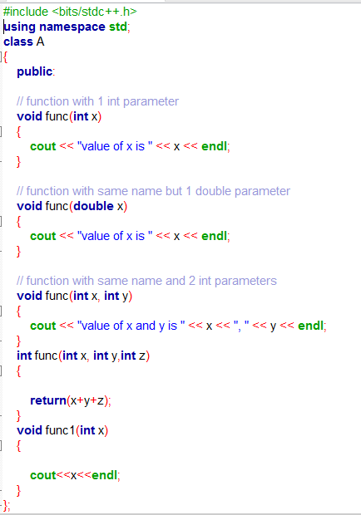
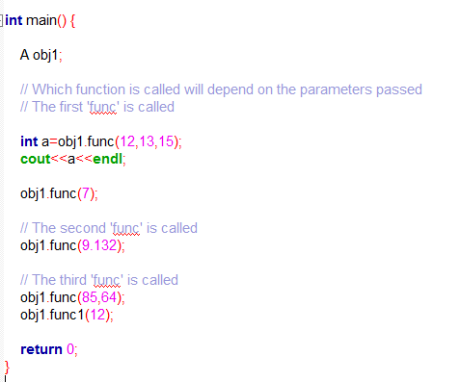
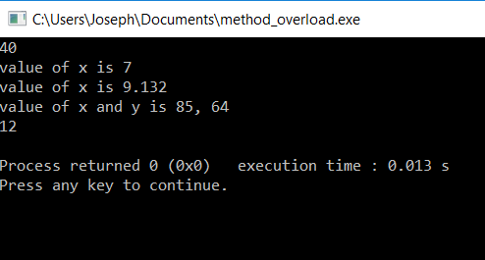
Try out Program

Slide 40
Questions
Which of the following permits function overloading on c++? a) type b) number of arguments c) type & number of arguments d) number of objects
Overloaded functions are ________________ a) Very long functions that can hardly run b) One function containing another one or more functions inside it c) Two or more functions with the same name but different number of parameters or type d) Very long functions
What should be passed in parameters when function does not require any parameters? a) void b) blank space c) both void & blank space d) tab space

Slide 41
Session 6, 7 & 8
Operator Overloading & Types

Slide 42

The utility of operators such as +, =, *, /, >, <, and so on is predefined in any programming language.
Programmers can use them directly on built-in data types to write their programs.
However, these operators do not work for user-defined types such as objects.
Therefore, C++ allows programmers to redefine the meaning of operators when they operate on class objects.
This feature is called operator overloading

Slide 43
Operator Overloading:
Operator – It is a symbol that indicates an operation. Arithmetic operators are + (add two numbers), - (subtract two numbers), * ( Multiply two numbers), / ( Divide between two numbers).
At now, we will take an Addition ‘+’ Sign, its use of ‘+’ sign is
5+5=10
2.5+2.5=5

Slide 44

Operator Overloading means multiple functions or multiple jobs. In operator overloading the ‘+’ sign use of add the two objects.
One of C++’s great features is its extensibility, Operator Overloading is major functionality related to extensibility.
In C++, most of operators can be overloaded so that they can perform special operations relative to the classes you create.

Slide 45
For Example, ‘+’ operator can be overloaded to perform an operation of string concatenation along with its pre-defined job of adding two numeric values.
When an operator is overloaded, none of its original meaning will be lost.
After overloading the appropriate operators, you can use C++’s built in data types.

Slide 46
Unary Operator
- Operators attached to a single operand. (-a, +a, --a, ++a, a--, a++)
Binary Operator
- Operators attached to two operand. (a-b, a+b, a*b, a/b, a%b, a>b, a<b )

Slide 47

return-type class-name:: operator op(arg-list)
{
function body
}
EXPLANATION
return type – It is the type of value returned by the specified operation.
op - It is the operator being overloaded. It may be unary or
binary operator. It is preceded by the keyword operator.
operator op - It is the function name, Where operator is a keyword.

Slide 48
Introduction
One of the exciting features of C++
Works only on the single variable
It can be overloaded two ways
Static member function
Friend function
-,+,++,-- those are unary operator which we can overloaded.

Slide 49
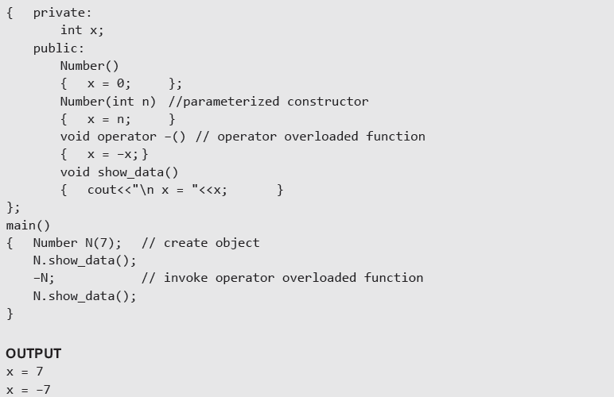
Using a member function to Overload Unary Operator

Slide 50
Using a Friend Function to Overload a Unary Operator
The function will take one operand as an argument.
This operand will be an object of the class.
The function will use the private members of the class only with the object name.
The function may take the object by using value or by reference.
The function may or may not return any value.
The friend function does not have access to the this pointer.

Slide 51
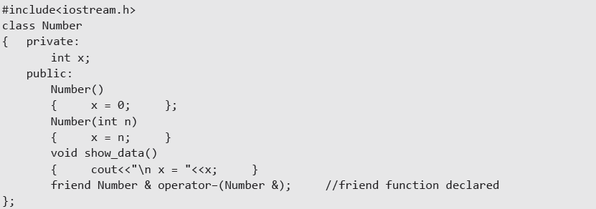
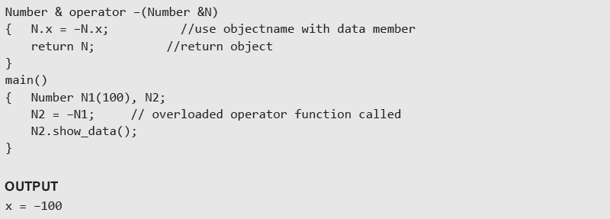
Example:- Use of friend function to overload a unary operator

Slide 52
Example Program:
Write a program which will convert an positive values in an object to negative value.
Code:
#include <iostream.h>
class demo
{
int x,y,z; public:
void getdata (int a, int b,int c)
{
x=a;
y=b; z=c;
}
Contd...,

Slide 53
void display(); void operator –();
};
void demo::display()
{
cout<<“x=“<<x<<“\ny=“<<y<<“\nz=“<<z<<endl;
}
void demo::operator –()
{
x=-x;
y=-y;
z=-z;
}
int main()
{
demo obj1;
CONTD...,

Slide 54
obj1.getdata(10,20,30); obj1.display();
-obj1; obj1.display(); return 0;
}
Output:
x=10
y=20 z=30
x=-10 y=-20 z=-30

Slide 55


Slide 56
INTRODUCTION
In Binary operator overloading function, there should be one argument to be passed.
It is overloading of an operator operating on two operands.

Slide 57
#include<iostream> class multiply
{
int first,second;
public:
void getdata(int a,int b)
{
first=a; second=b;
}
Contd...,

Slide 58
void display()
{
cout<<“first=“<<first<<“second=“<<secon<<endl;
}
multiply operator *(multiply c);
};
void multiply::operator *(multiply c)
{
multiply temp; temp.first=first*c.first; temp.second=second*c.second; return temp;
}
Contd..,

Slide 59
int main()
{
multiply obj1,obj2,obj3; obj1.getdata(15,20); obj2.getdata(3,45); obj3=obj1*obj2; obj3.display();
return 0;
}
Output:
45
900

Slide 60
MCQ Questions
In case of operator overloading, operator function must be ______ .
1. Static member functions
2. Non- static member functions
3. Friend Functions
a. Only 2
b. Only 1, 3
c. Only 2 , 3
d. All 1 , 2, 3

Slide 61
MCQ Questions
In case of operator overloading, operator function must be ______ .
1. Static member functions
2. Non- static member functions
3. Friend Functions
a. Only 2
b. Only 1, 3
c. Only 2 , 3
d. All 1 , 2, 3

Slide 62
MCQ Questions
II. Using friend operator function, following perfect set of operators may not be overloaded.
a. = , ( ) , [ ] , ->
b. <<, = = , [ ] , >>
c. ?, = , ( ) , ++
d. +,-,--,++

Slide 63
MCQ Questions
II. Using friend operator function, following perfect set of operators may not be overloaded.
a. = , ( ) , [ ] , ->
b. <<, = = , [ ] , >>
c. ?, = , ( ) , ++
d. +,-,--,++

Slide 64
MCQ Questions
III. When overloading unary operators using Friend function,it requires_____ argument/s.
a. Zero
b. One
c. Two
d. None of these.

Slide 65
MCQ Questions
III. When overloading unary operators using Friend function,it requires_____ argument/s.
a. Zero
b. One
c. Two
d. None of these.

Slide 66
MCQ Questions
IV. In case of binary operator overloading with member function, which of following statement should be taken into consideration?
a. Right hand operand must be object.
b. Left hand operand must be object.
c. Both the operands must be objects.
d. All of these should be considered.

Slide 67
MCQ Questions
IV. In case of binary operator overloading with member function, which of following statement should be taken into consideration?
a. Right hand operand must be object.
b. Left hand operand must be object.
c. Both the operands must be objects.
d. All of these should be considered.

Slide 68
MCQ Questions
V.Which is the correct statement anout operator overloading in C++?
A. Only arithmetic operators can be overloaded
B. Only non-arithmetic operators can be overloaded
C. Precedence of operators are changed after overlaoding
D. Associativity and precedence of operators does not change

Slide 69
MCQ Questions
V. Which is the correct statement anout operator overloading in C++?
A. Only arithmetic operators can be overloaded
B. Only non-arithmetic operators can be overloaded
C. Precedence of operators are changed after overlaoding
D. Associativity and precedence of operators does not change

Slide 70
Session 11
UML Sequence Diagram

Slide 71
Interaction Diagram
Interaction diagrams are used to observe the dynamic behavior of a system.
Interaction diagram visualizes the communication and sequence of message passing in the system.
Interaction diagram represents the structural aspects of various objects in the system.
Interaction diagram represents the ordered sequence of interactions within a system.
Interaction diagram provides the means of visualizing the real time data via UML.

Slide 72
This interactive behavior is represented in UML by two diagrams known as
Sequence diagram
Collaboration diagram.
Sequence diagram emphasizes on time sequence of messages from one object to another.
Collaboration diagram emphasizes on the structural organization of the objects that send and receive messages.

Slide 73
How to Draw an Interaction Diagram?
The purpose of interaction diagrams is to capture the dynamic aspect of a system.
So to capture the dynamic aspect, we need to understand what a dynamic aspect is and how it is visualized. Dynamic aspect can be defined as the snapshot of the running system at a particular moment.
Following things are to be identified clearly before drawing the interaction diagram
Objects taking part in the interaction.
Message flows among the objects.
The sequence in which the messages are flowing.
Object organization.

Slide 74
Sequence Diagram
A sequence diagram simply depicts interaction between objects in a sequential order i.e. the order in which these interactions take place.

Slide 75
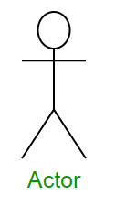
Sequence Diagram Notations
Actors :
An actor in a UML diagram represents a type of role where it interacts with the system and its objects.

Slide 76
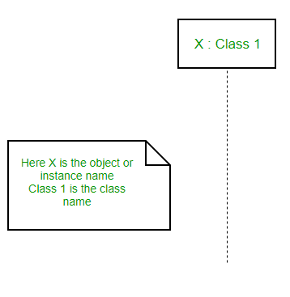
2.Lifelines :
A lifeline is a named element which depicts an individual participant in a sequence diagram. So basically each instance in a sequence diagram is represented by a lifeline.
Lifeline elements are located at the top in a sequence diagram.
lifeline follows the following format :
Instance Name : Class Name

Slide 77
3.Messages :
Communication between objects is depicted using messages. The messages appear in a sequential order on the lifeline.
We represent messages using arrows. Lifelines and messages form the core of a sequence diagram.

Slide 78
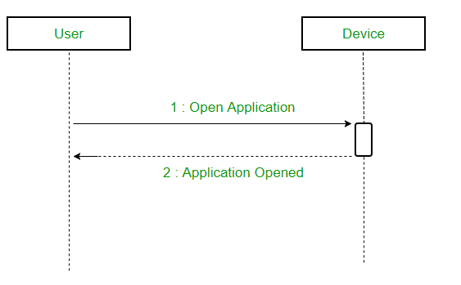
Synchronous messages
A synchronous message waits for a reply before the interaction can move forward.
The sender waits until the receiver has completed the processing of the message.
The caller continues only when it knows that the receiver has processed the previous message i.e. it receives a reply message.
A large number of calls in object oriented programming are synchronous. We use a solid arrow head to represent a synchronous message.

Slide 79
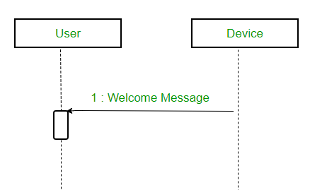
Asynchronous Messages
An asynchronous message does not wait for a reply from the receiver.
The interaction moves forward irrespective of the receiver processing the previous message or not.
We use a lined arrow head to represent an asynchronous message.

Slide 80
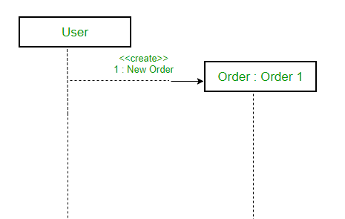
Create message
We use a Create message to instantiate a new object in the sequence diagram.
It is represented with a dotted arrow and create word labeled on it to specify that it is the create Message symbol. For example :
The creation of a new order on a e-commerce website would require a new object of Order class to be created.

Slide 81
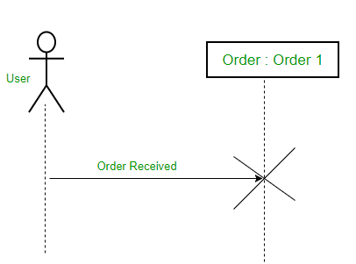
Delete Message
We use a Delete Message to delete an object.
It destroys the occurrence of the object in the system.
It is represented by an arrow terminating with a x. For example – In the scenario below when the order is received by the user, the object of order class can be destroyed

Slide 82
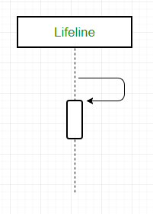
Self Message
A message an object sends to itself, usually shown as a U shaped arrow pointing back to itself.

Slide 83

Reply Message
Reply messages are used to show the message being sent from the receiver to the sender.
We represent a return/reply message using an open arrowhead with a dotted line.
The interaction moves forward only when a reply message is sent by the receiver.

Slide 84
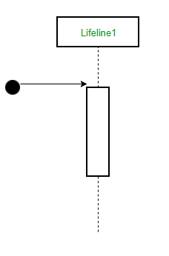
Found Message
A Found message is used to represent a scenario where an unknown source sends the message.
It is represented using an arrow directed towards a lifeline from an end point.

Slide 85
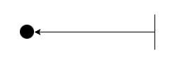
Lost Message
A Lost message is used to represent a scenario where the recipient is not known to the system.
It is represented using an arrow directed towards an end point from a lifeline.
For example:

Slide 86
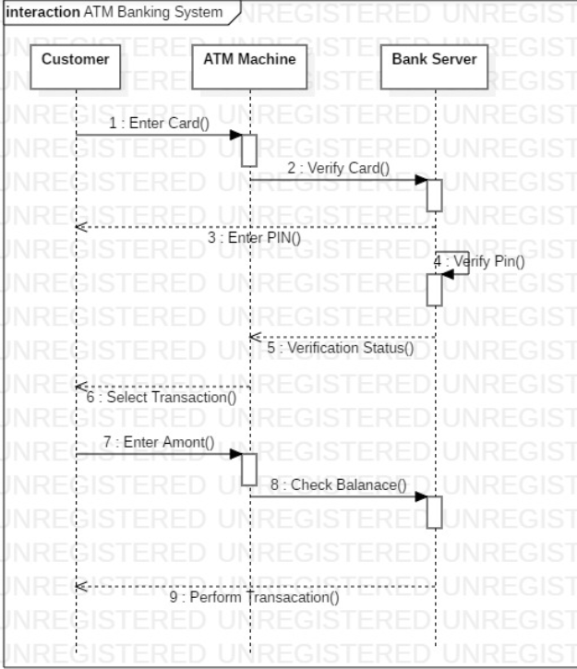
Example – Sequence Diagram

Slide 87
Questions
What does a message mean? a) It Passes all communications from one object to another and are represented by message arrows in sequence diagrams. b) The message goes from the sending object’s lifeline to the receiving object’s lifeline. c) It is a rectangle containing an identifier with a dashed line extending below the rectangle. d) List of all attributes.
What is a lifeline? a) It is a frame consisting of a rectangle with a pentagon in its upper left-hand corner b) It is a rectangle containing an identifier with a dashed line extending below the rectangle c) It is a name compartment; the interaction is represented inside the rectangle d) Emergency situation in real world approach.

Slide 88
Session 12
UML Collaboration Diagram

Slide 89
COLLABORATION DIAGRAM depicts the relationships and interactions among software objects. They are used to understand the object architecture within a system rather than the flow of a message as in a sequence diagram. They are also known as “Communication Diagrams.” In the collaboration diagram, the method call sequence is indicated by some numbering technique. The number indicates how the methods are called one after another.
Collaboration diagram

Slide 90
It is also called as a communication diagram. It emphasizes the structural aspects of an interaction diagram - how lifeline connects. Its syntax is similar to that of sequence diagram except that lifeline don't have tails. Messages passed over sequencing is indicated by numbering each message hierarchically. Compared to the sequence diagram communication diagram is semantically weak. Object diagrams are special case of communication diagram. It allows you to focus on the elements rather than focusing on the message flow as described in the sequence diagram. Sequence diagrams can be easily converted into a collaboration diagram as collaboration diagrams are not very expressive.
Benefits of Collaboration Diagram

Slide 91
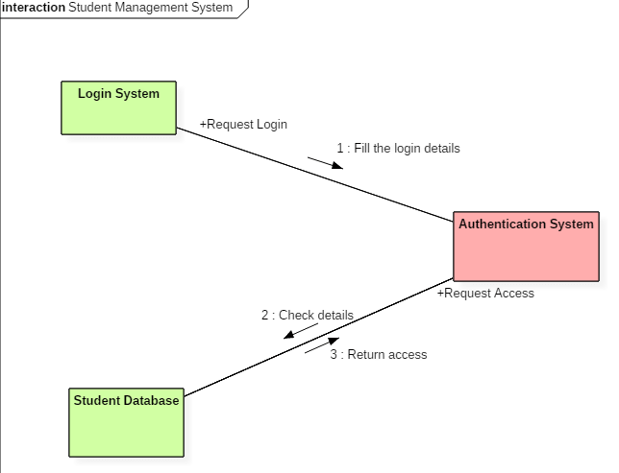
Example
Following diagram represents the sequencing over student management system:

Slide 92
The above collaboration diagram represents a student information management system. The flow of communication in the above diagram is given by, A student requests a login through the login system. An authentication mechanism of software checks the request. If a student entry exists in the database, then the access is allowed; otherwise, an error is returned.
Example

Slide 93
1. A collaboration diagram shows a. Structural Aspect b. Behavioral Aspect c. Environmental Aspect d. Both A and B e. Both B and C 2. which diagram is used to show interactions between messages are classified as? a.activity b.state chart c.collaboration d.object lifeline
MCQ’s

Slide 94
Session 13
Inheritance & Types

Slide 95


Inheritance
Inheritance is the capability of one class to acquire properties and characteristics from another class. The class whose properties are inherited by other class is called the Parent or Base or Super class. And, the class which inherits properties of other class is called Child or Derived or Sub class.
01
Definition
02
Syntax
Single Inheritance, Multiple Inheritance, Hierarchical Inheritance, Multilevel Inheritance, and Hybrid Inheritance (also known as Virtual Inheritance)
Note : All members of a class except Private, are inherited
03
Types
Code Reusability
Method Overriding (Hence, Runtime Polymorphism.)
Use of Virtual Keyword
04
Advantages

Slide 96
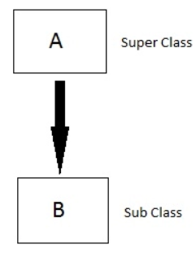
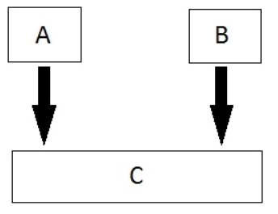
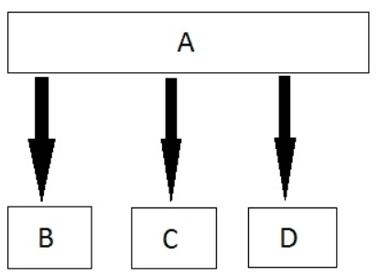
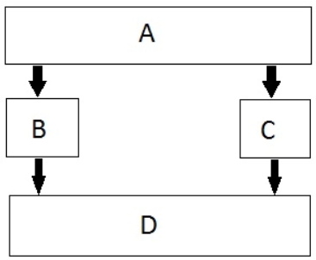
Inheritance Types
01
Single
02
Multiple
03
Hierarchical
04
Multilevel
05
Hybrid

Slide 97
Modes of Inheritance
If we derive a sub class from a public base class. Then the public member of the base class will become public in the derived class and protected members of the base class will become protected in derived class
01
Public
If we derive a sub class from a Protected base class. Then both public member and protected members of the base class will become protected in derived class.
02
Protected
If we derive a sub class from a Private base class. Then both public member and protected members of the base class will become Private in derived class.
03
private
The private members in the base class cannot be directly accessed in the derived class, while protected members can be directly accessed. For example, Classes B, C and D all contain the variables x, y and z in below example
Note:

Slide 98
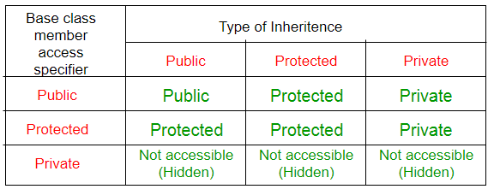
Inheritance Access Matrix

Slide 99


